Slide 1
Day 2: Introduction to Visualizations
matplotlib
Notes:
Taken at a high level visualizations are

Slide 2
Summarize
Notes:
A way to summarize the

Slide 3
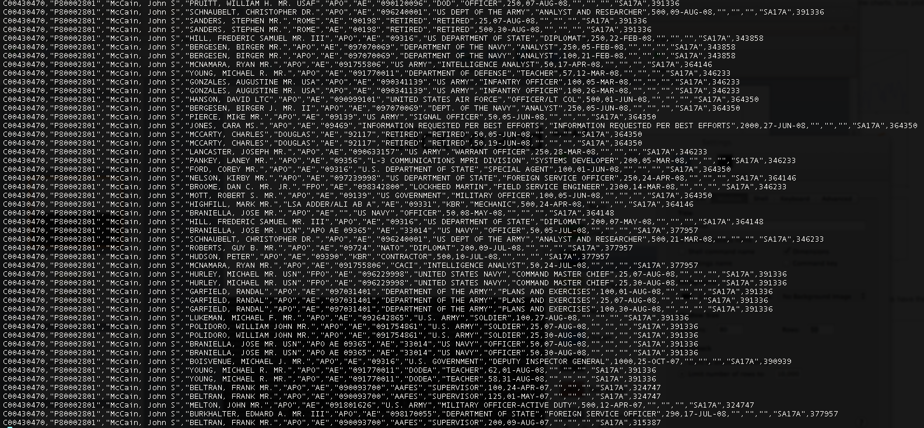
Complex
Notes:
Complex data that you’ve downloaded

Slide 4
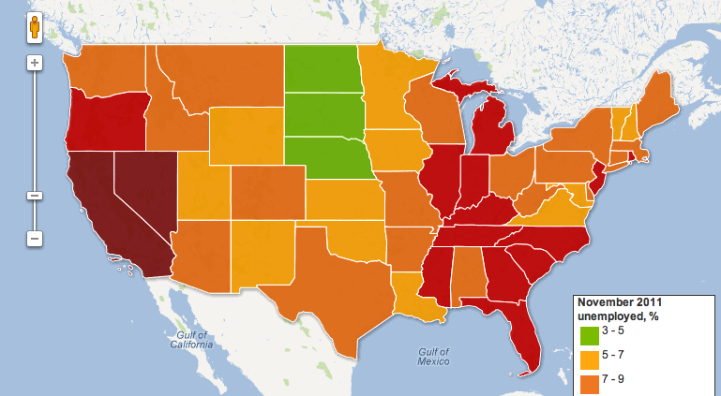
http://www.guardian.co.uk/news/datablog/2011/oct/07/us-jobless-unemployment-data
Notes:
And show different parts or interpretations of the data using shapes and colors instead of text.

Slide 5
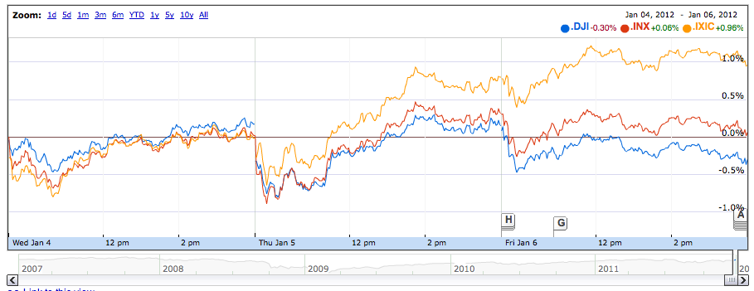
finance.google.com

Slide 6
2

Slide 7
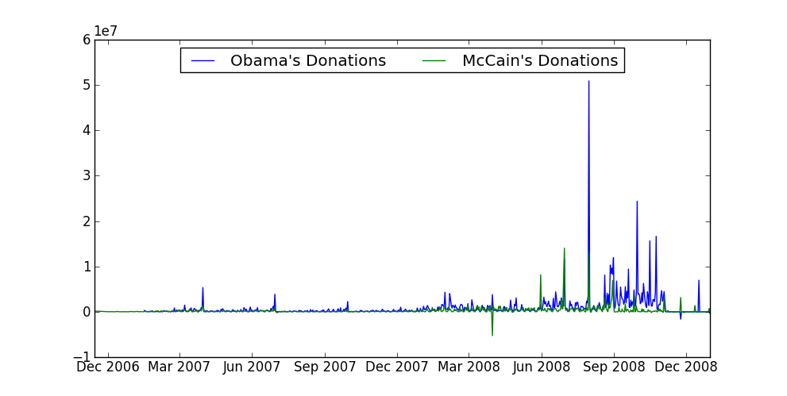
Exploring
Notes:
Scanning is a set of quick visualizations that give you an overview of the data, so that you can make hypotheses and figure out what to focus on next. These are quick and dirty graphs

Slide 8
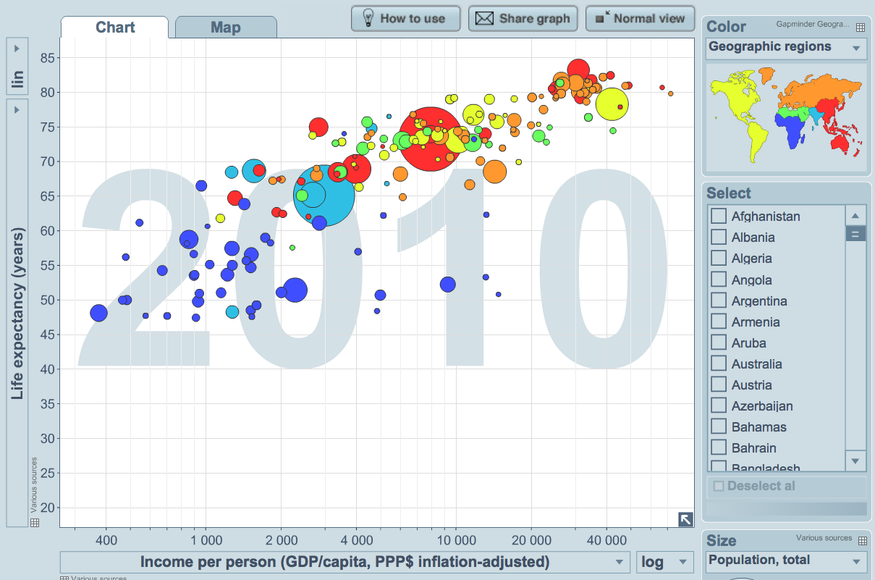
Storytelling
http://www.gapminder.org/
Notes:
Storying telling is what you often see when you are looking at a visualization. It’s purpose is to visually tell you some interesting fact.

Slide 9
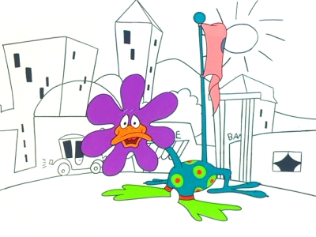
Animation?

Slide 10
Animation?
ONLY SOMETIMES
Notes:
----- Meeting Notes (1/10/12 11:02) -----
We won't teach you animations

Slide 11

“The Message”
Grandmaster Flash (1982)
Notes:
What matters is the message. The core idea

Slide 12
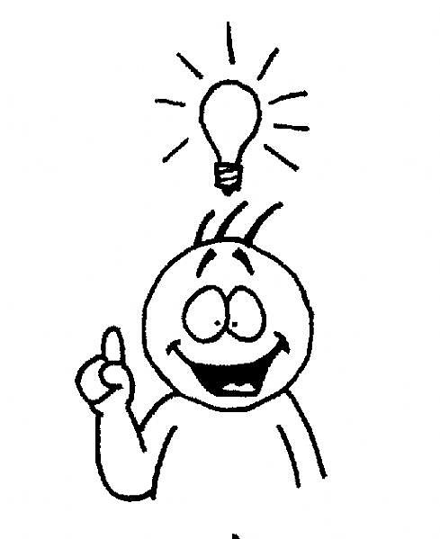
http://www.julieelder.com/wp-content/uploads/2010/11/understand_full.jpg
Notes:
and getting the reader to see your idea

Slide 13

Notes:
As quickly as possible.

Slide 14
Visualization != Sexy Pictures
Notes:
Today, We will not teach you to draw sexy pictures

Slide 15
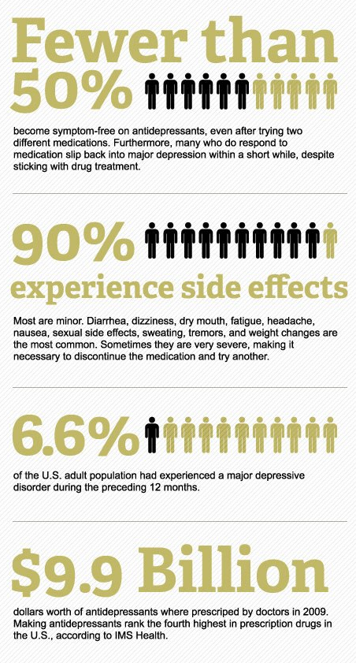
http://psychcentral.com/blog/archives/2011/06/29/an-epidemic-of-bad-infographics-depression/
Notes:
Such as infographics, which can often be hard to read

Slide 16
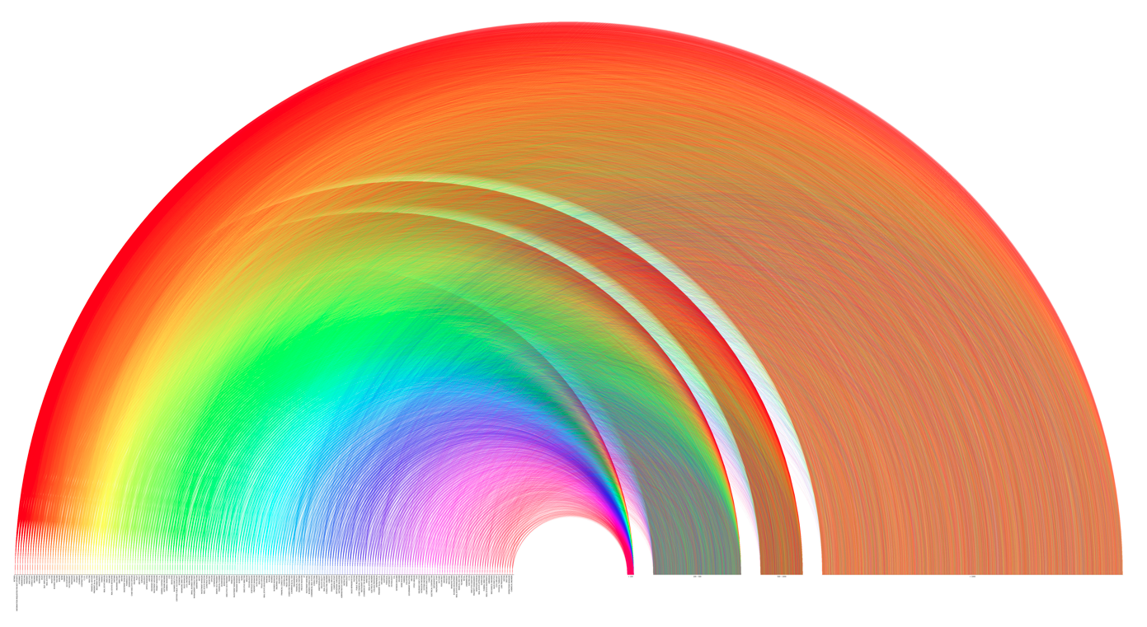
http://www.pitchinteractive.com/election2008/jobarcs.html
Notes:
We won’t teach you how to create beautiful pictures

Slide 17
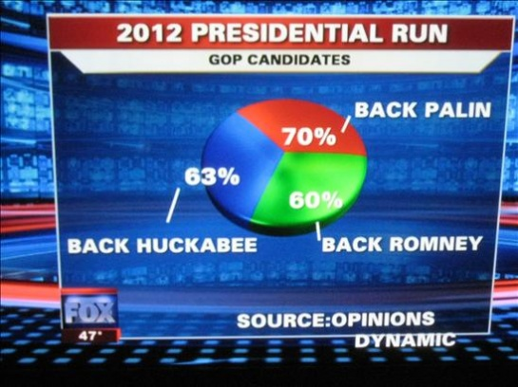
http://visualizeit.wordpress.com/category/bad-visualization/
Notes:
And we encourage you to be factually correct

Slide 18
The Basics

Slide 19
The Basics
blog.okcupid.com
Notes:
If you want to see great visualizations using what we teach today, head to blog.okcupid.com. We stole most of the slide charts from there.

Slide 20
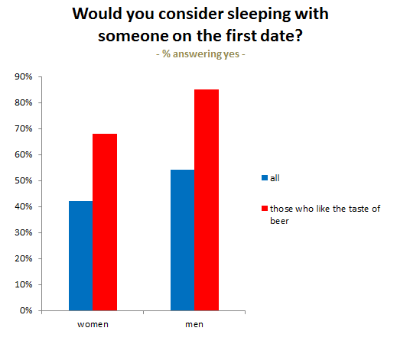
Bar Graph
http://blog.okcupid.com
Notes:
categories

Slide 21
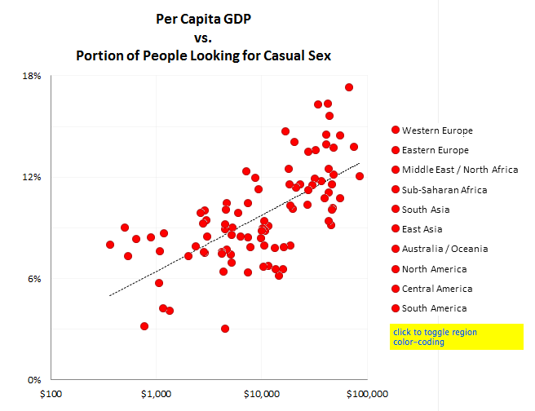
Scatter Plot
http://blog.okcupid.com
Notes:
Two variables, usually to see if there exists a trend between the two variable
----- Meeting Notes (1/10/12 11:02) -----
two continuous variables.

Slide 22
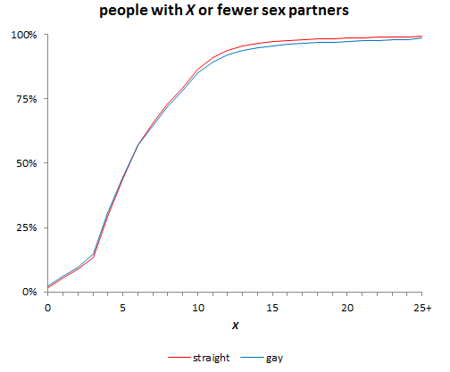
Line Graph
http://blog.okcupid.com
Notes:
X axis is strictly increasing series. Lines drawn between points because we expect trends.

Slide 23
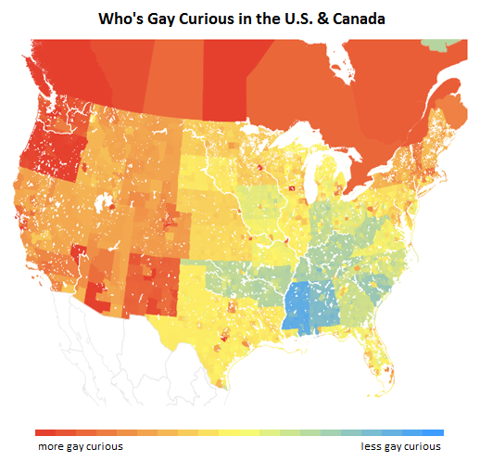
Choropleth Plots
http://blog.okcupid.com
Notes:
Map.

Slide 24
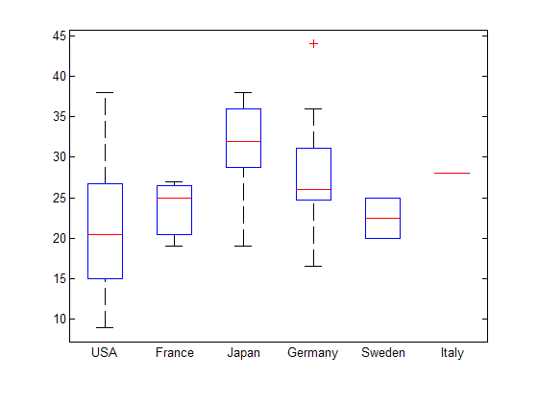
Box Plots

Slide 25
matplotlib
Python’s version of Matlab plotting

Slide 26
How matplotlib Draws
Notes:
Confused me for a long time. Super powerful, so every has a lot of options. Documentation isn’t great.

Slide 27
Figure object
Figure

Slide 28
Subplot object
Draw in here
Subplot
Draw in here
Figure

Slide 29
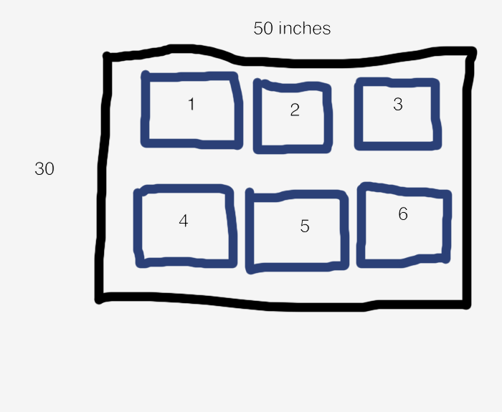
figure.add_subplot(2, 3, 1)
2
rows
3 columns

Slide 30
figure.add_subplot(2, 3, 1)
2
rows
3 columns

Slide 31
figure.add_subplot(2, 3, 1)
2
rows
3 columns

Slide 32
figure.add_subplot(2, 3, 1)
1
2
rows
3 columns

Slide 33
Charting Library
subplot.bar()
subplot.plot()
subplot.scatter()
subplot.boxplot()
Notes:
The all end up simply drawing

Slide 34
Lines
Subplot
Figure

Slide 35
Boxes
Subplot
Figure

Slide 36
Polygons
Subplot
Figure

Slide 37
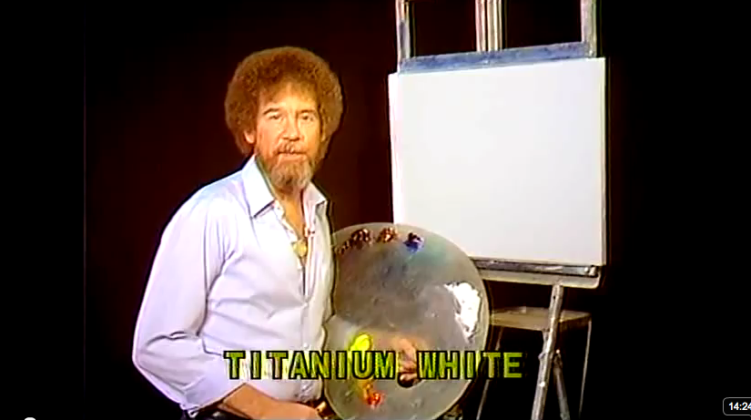
Painting

Slide 38
Overlaps
Subplot
Figure

Slide 39
Overlaps
Subplot
Figure

Slide 40
Choropleth Plots
http://blog.okcupid.com
Notes:
Map.

Slide 41
No Easy Way

Slide 42
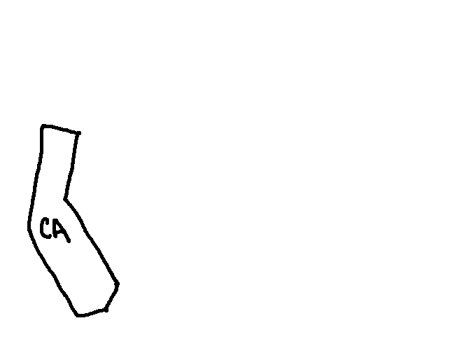
How Maps are Drawn
Notes:
----- Meeting Notes (1/10/12 11:02) -----
shape boundary

Slide 43
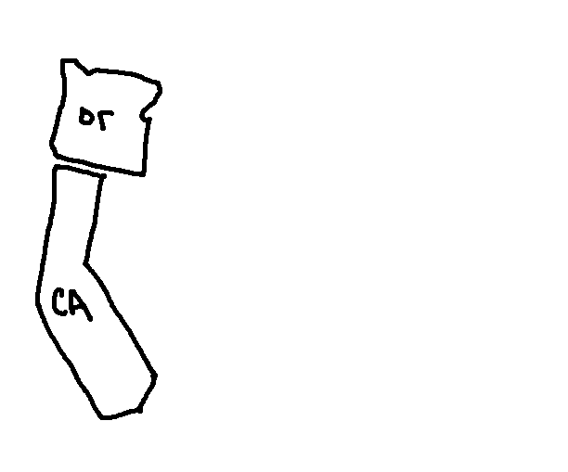
How Maps are Drawn

Slide 44
Helper Functions
FIPS
draw_county(subplot, county_id, color)
draw_state(subplot, state, color)

Slide 45
dataiap.github.com/dataiap/day2/

Slide 46
git

